Slide 1
Module 02
AC Power Transmission and PSCAD

Slide 2
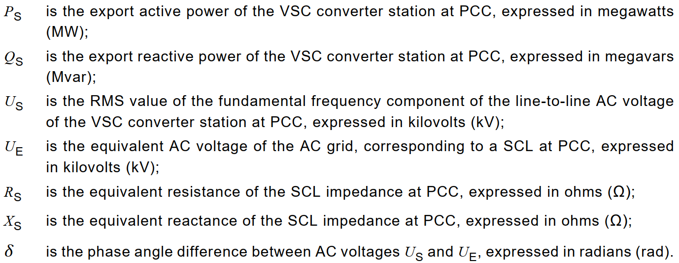
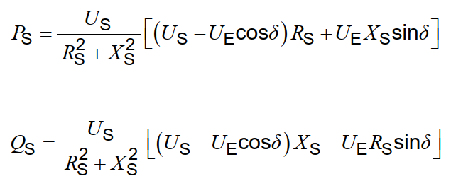
Power exchange in AC grid
IEC TR 63363-1:2022

Slide 3
Power exchange
Parameter | Case 1 | Case 2 | Case 3 | Case 4
P_{S} | 1000 MW | 1500 MW | 1000 MW | -1000 MW
U_{E} | 230 kV | 230 kV | 230 kV | 230 kV
U_{S} | 232 kV | 232 kV | 240 kV | 232 kV
R_{S} | 0.144 Ω | 0.144 Ω | 0.144 Ω | 0.144 Ω
X_{S} | 1.15 Ω | 1.15 Ω | 1.15 Ω | 1.15 Ω
δ | 1.19° | 1.816° | 1.081° | -1.319°
Q_{S} | 288 MVAr | 239 MVAr | 905 MVAr | 541 MVAr
For active power transmission reactive power is necessary
Increase of AC voltage increases the demand of the reactive power
Changing of power flow direction changes also the reactive power demand

Slide 4
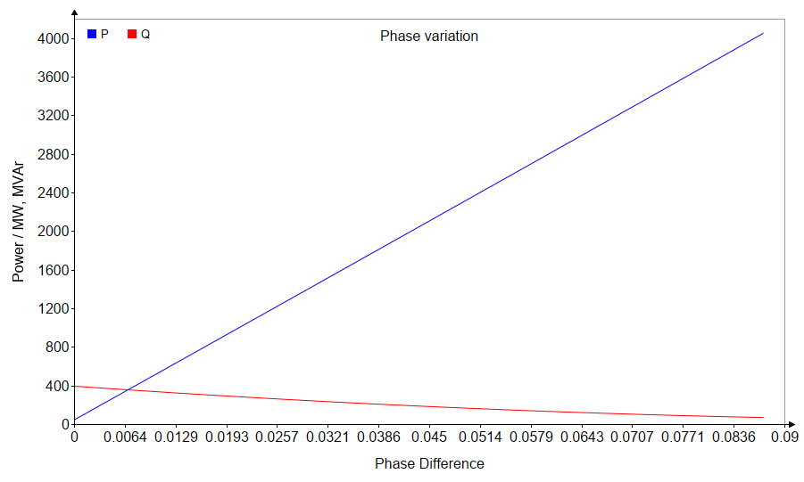
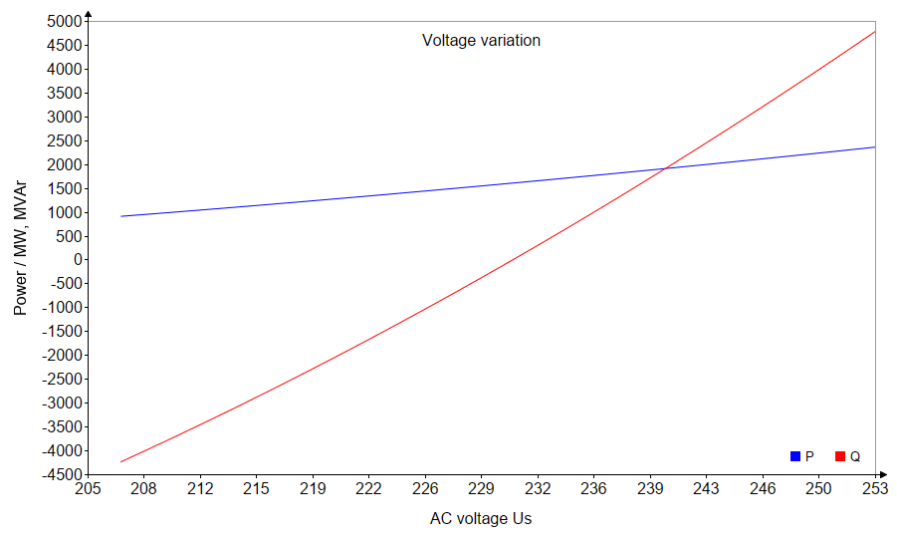
Power exchange
Active power transmission is done by phase difference variation
Reactive power transmission is done by voltage amplitude

Slide 5
Power Transmission in AC grid
Principles of AC power transmission are demonstrated with a simple AC network
Grid is connected to the load with the impedance Z_{L} via an AC cable with length L_{cable}

Slide 6
Transmission line is represented by 2-port units
Parameter |  | OHL | Cable (XLPE)
C’_{L} | nF/km | 10 | 180 - 420
R’_{L} | Ω/km | 0.1 - 1 | 0.1 - 1
X’_{L} | mH/km | 1 | 0.31 – 1.42
G’_{L} | μS/km | 0.05 | 1
Cable Parameters for following examples:
C’_{L} = 190 nF/km
R’_{L} = 22 mΩ/km
X’_{L} = 1.35 mH/km
AC line can be represented by a π-section model
AC cables are dominated by capacitances
AC overhead lines (OHL) are dominated by inductances

Slide 7
Power Transmission in AC grid
Parameter | Value
U_{S, L-L} | 230 kV 1.0 p.u
I_{S} | 1060 A
P_{S} | 2.2 MW
Q_{S} | -421 MVAr
U_{R, L-L} | 1.22 p.u.
I_{R} | 0 A
P_{R} | 0 MW
Q_{R} | 0 MVAr
L_{cable} | 60 mi
No Load is connected to the AC line
Connection of an AC cable creates a significant current flow and reactive power demand

Slide 8
Power Transmission in AC grid
Parameter | Value
U_{S, L-L} | 230 kV 1.0 p.u
I_{S} | 40 A
P_{S} | 2.2 MW
Q_{S} | -14.4 MVAr
U_{R, L-L} | 1.22 p.u.
I_{R} | 830 A
P_{R} | 0 MW
Q_{R} | -277 MVAr
L_{cable} | 60 mi
Q_{comp} | 400 MVAr
AC grid operator would usually not allow an uncompensated AC cable connection
Reactive power compensation with a shunt reactor with the rating Q_{comp} is usually required

Slide 9
Power Transmission in AC grid
Parameter | Value
U_{S, L-L} | 230 kV 1.0 p.u
I_{S} | 1340 A
P_{S} | 511 MW
Q_{S} | -150 MVAr
U_{R, L-L} | 1.06 p.u.
I_{R} | 1180 A
P_{R} | 500 MW
Q_{R} | 0 MVAr
L_{cable} | 60 mi
Power transmission decreases the voltage increase
Decreased reactive power demand

Slide 10
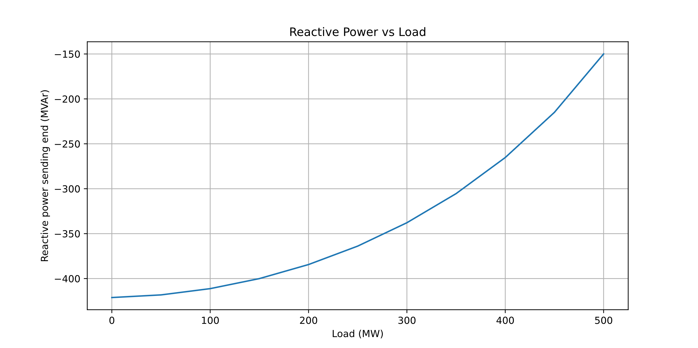
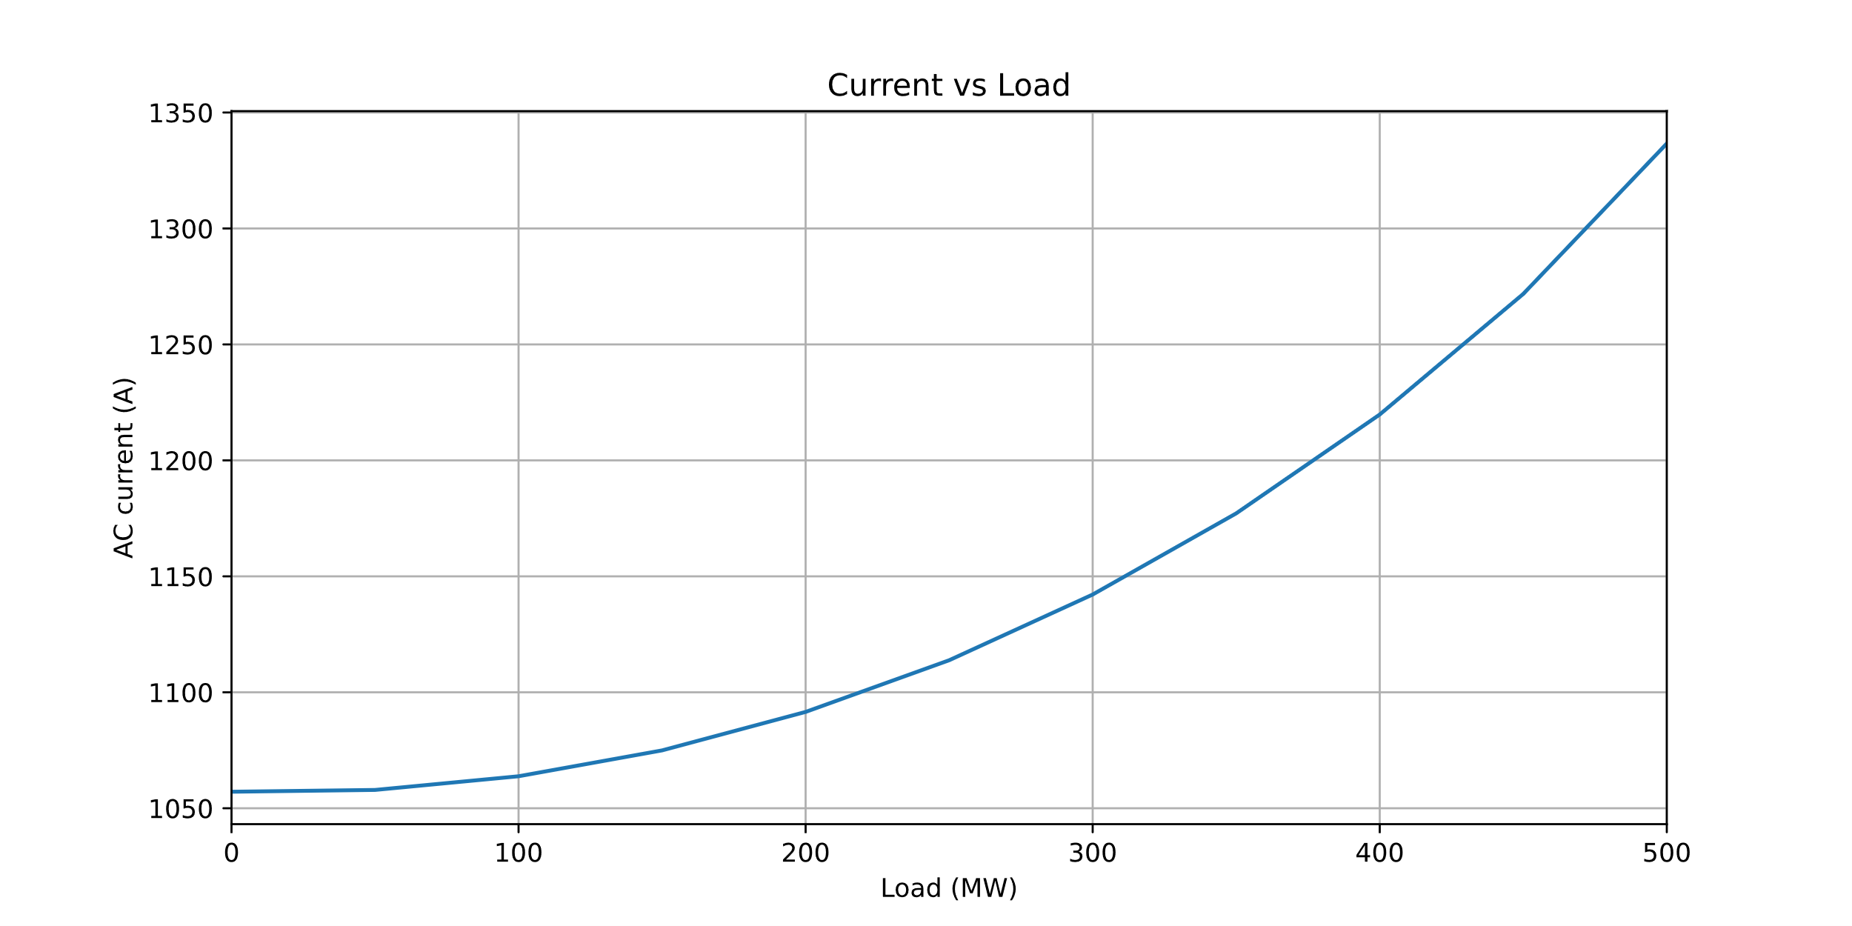
Power Transmission in AC grid

Slide 11
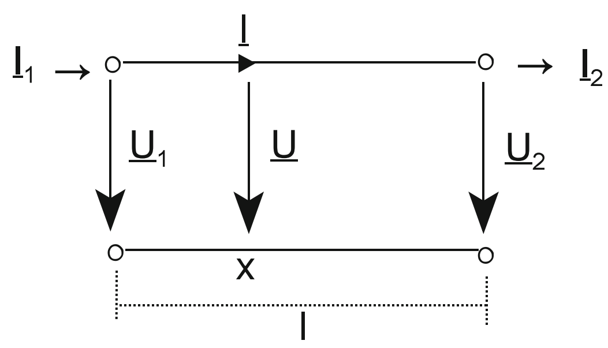

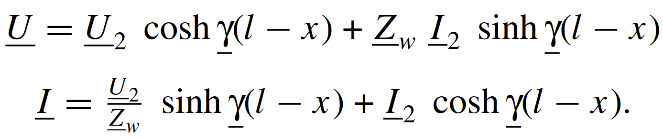
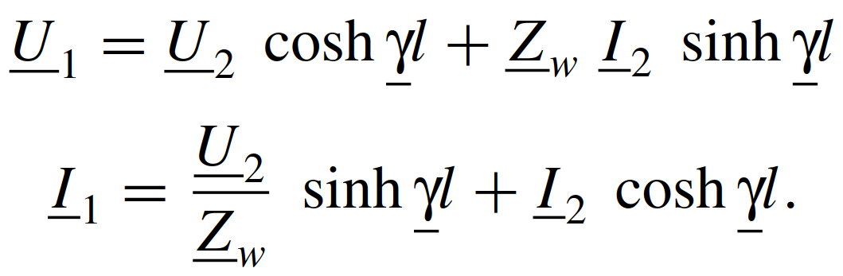
Transmission line is represented by 2-port units
Wave impedance
Propagation level:
Voltage calculation along the line
2-port parameters calculations

Slide 12
Link collection
Over Head Line (OHL) conductor data:
https://www.southwire.com/wire-cable/bare-aluminum-overhead-transmission-distribution/c/c-bare-aluminum-overhead
AC Cable data:
https://new.abb.com/docs/default-source/ewea-doc/xlpe-submarine-cable-systems-2gm5007.pdf
PSCAD Tutorials and information
https://www.pscad.com/knowledge-base/topic-281/v-
https://www.pscad.com/knowledge-base/article/44

